Slide 1

DA Domain Admin in Under 30
(Internal Edition)

Slide 2

Yes, the most boring slide.
Mike Kannan – Director of Security at GraVoc
Pentesting for over 10 years
I enjoy long walks on the beach, but not if it’s windy
Chris Barretto – Senior Security at GraVoc
Pentesting for over 5 years

Slide 3
Let’s get down to business…

Slide 4


Slide 5
#1 Way from “Zero to Hero”
Device is plugged into network, grab an IP from DHCP or review packets in Wireshark/tcpdump and assign static IP
Run crackmapexec and generate and SMB relay list (computers that do not enforce SMB signing)
Run responder with SMB and HTTP set to Off alongside ntlmrelayx from impacket using the list from crackmapexec and watch the hashes fly by
Spray credentials across network using crackmapexec

Slide 6
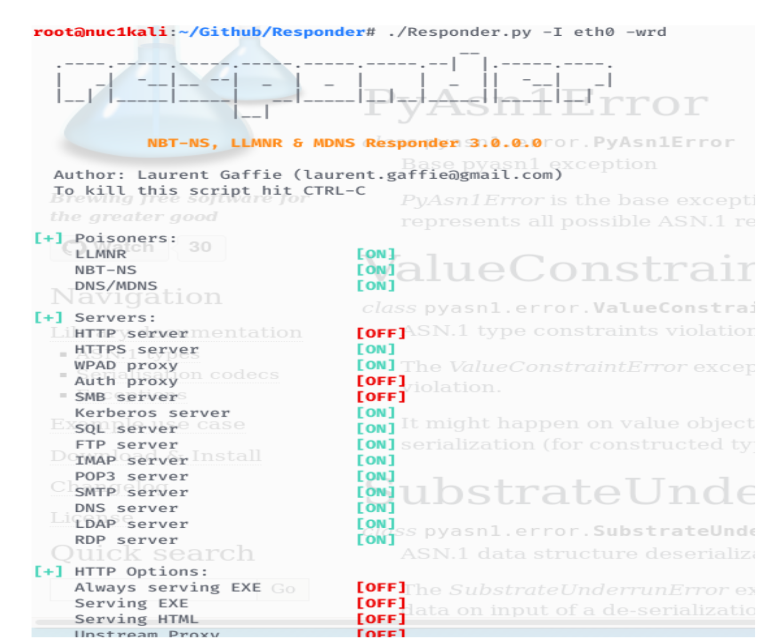

Slide 7
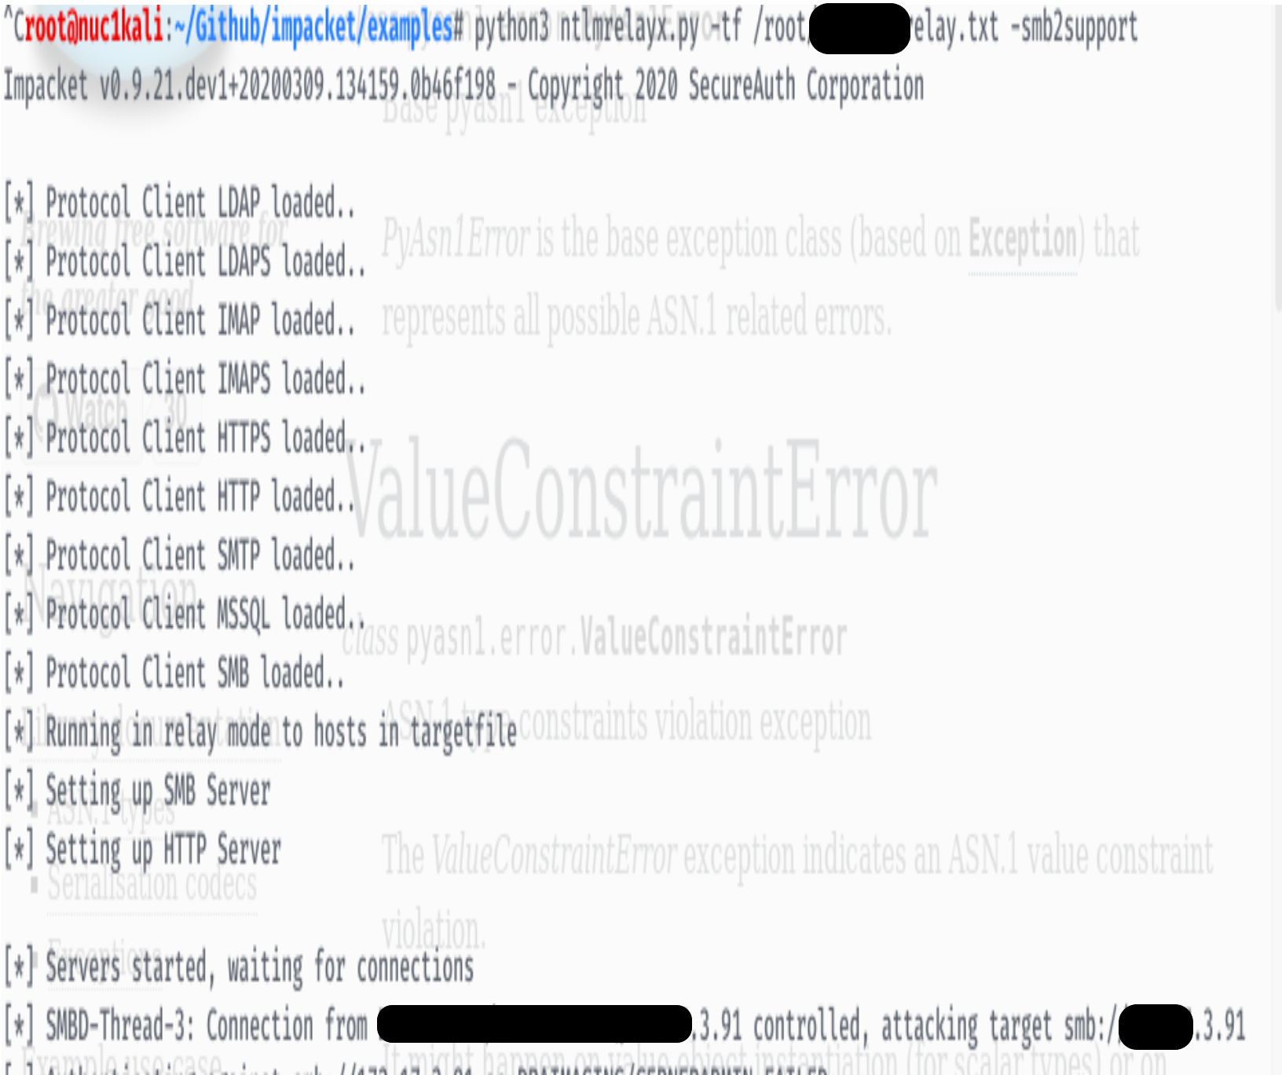

Slide 8
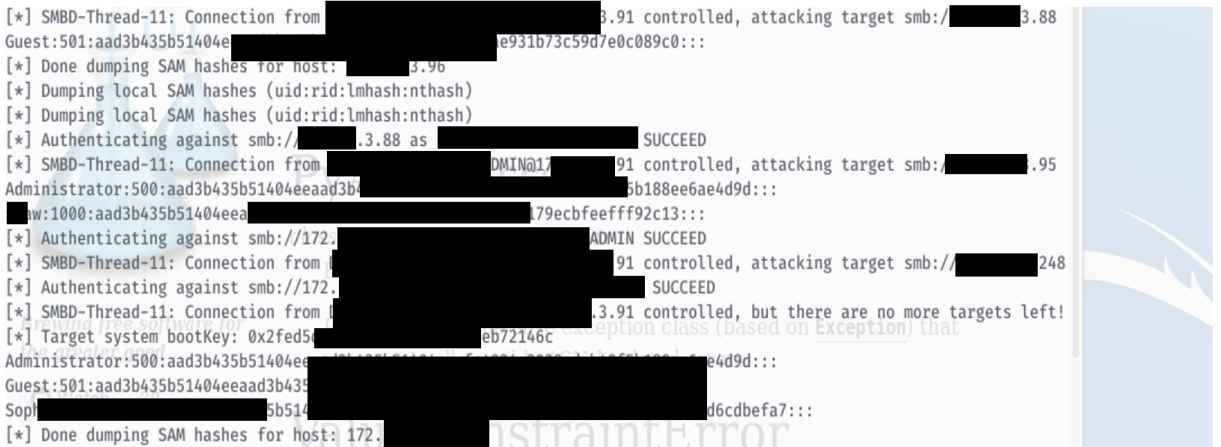

Slide 9
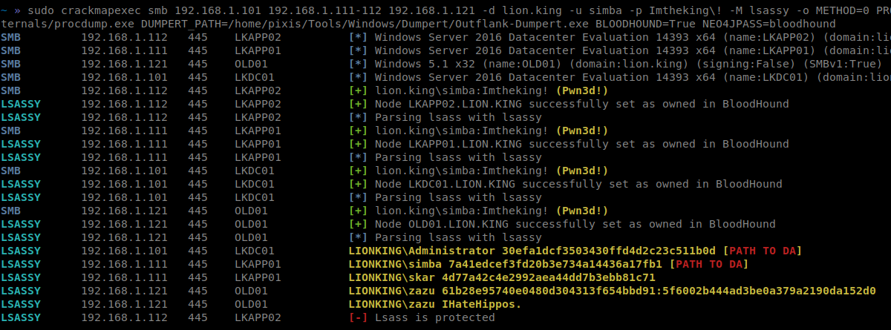
Reference: https://github.com/Hackndo/lsassy/tree/master/cme

Slide 10
#2 Way from “Zero to Hero”
Scan entire network for iLO (Dell, HP, SuperMicro, etc.)
Dump IPMI hashes
Crack IPMI hashes
HP iLO default is typically numbers and all uppercase letters
Dell iDRAC default is typically calvin
SuperMicro default is typically ADMIN
Look for backup admin or password reuse
Spray credentials using crackmapexec

Slide 11
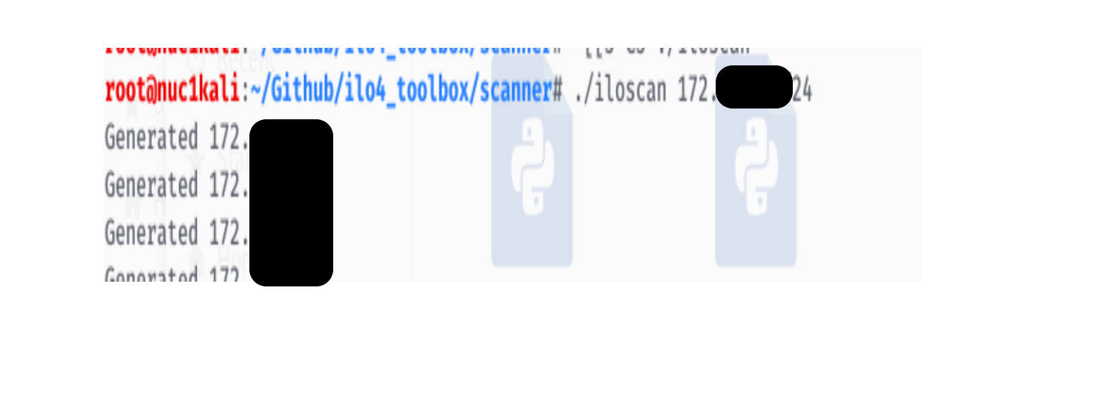
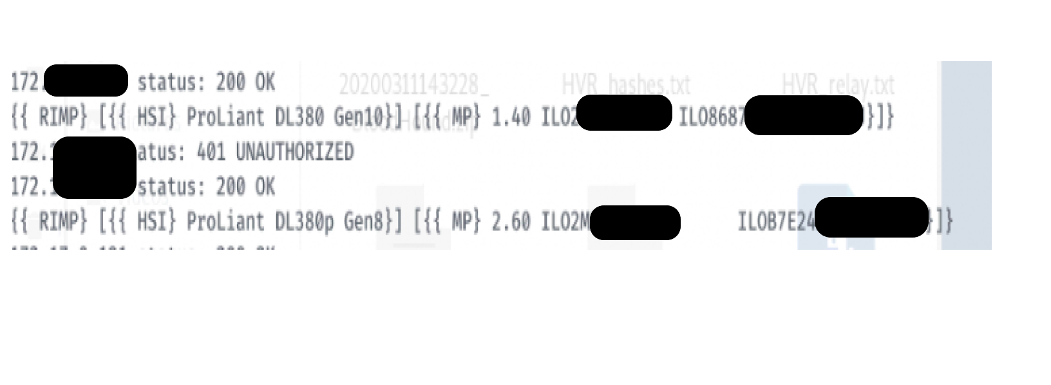

Slide 12
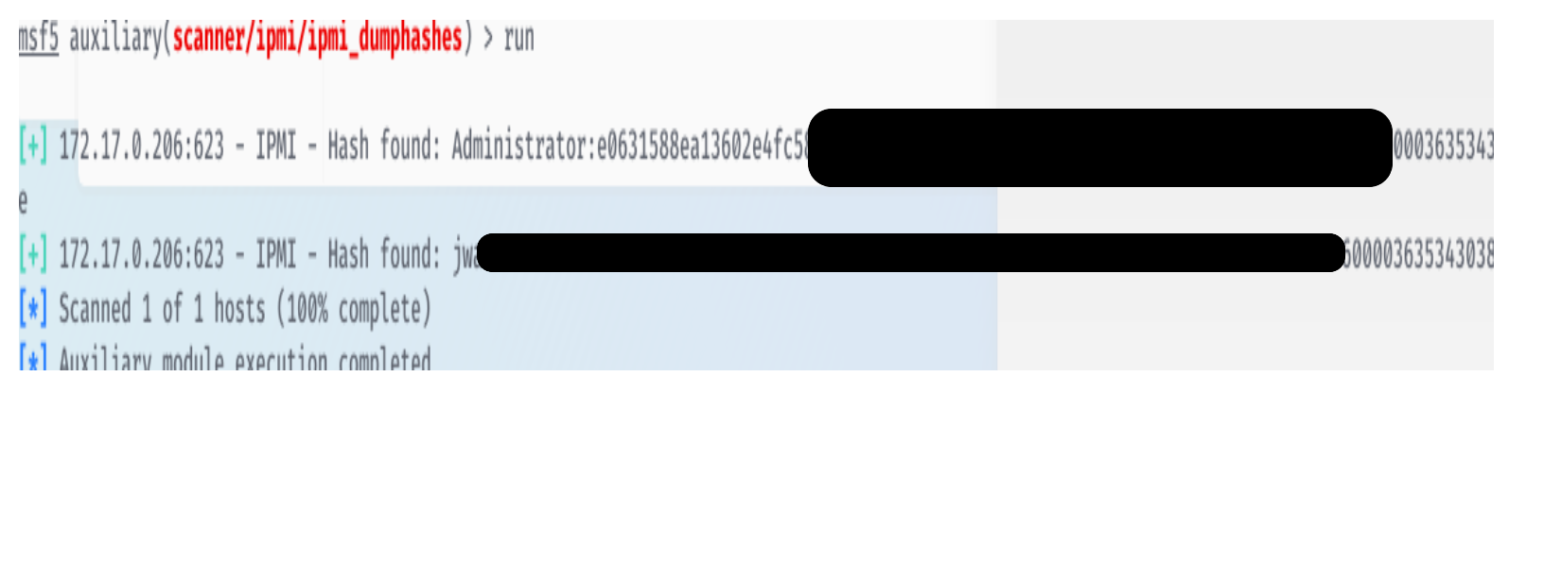
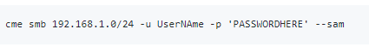

Slide 13
#3 Way from “Zero to Hero”
Scan entire network for open NFS
Mount NFS share
Look for interesting files, such as a backup appliance that contains a DC backup
Extract ntds file
Crack away

Slide 14
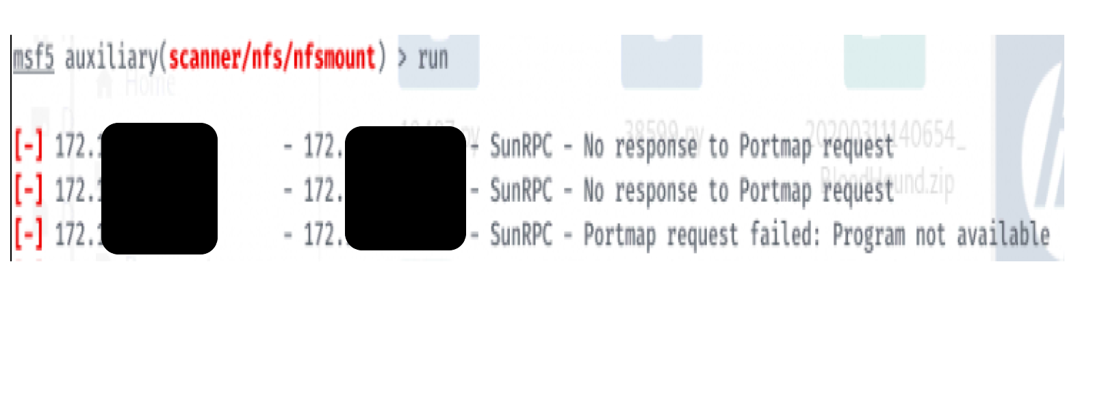

Slide 15
#4 Way from “Zero to Hero”
Scan entire network for open printers (typically use nmap)
Check for default credentials on every printer
If successful, look for LDAP authentication/email/scan to file share settings
Change share or IP to attacker IP and run a test
Run rogue server (responder or nc)
Credentials will be sent to attacker machine of that account

Slide 16
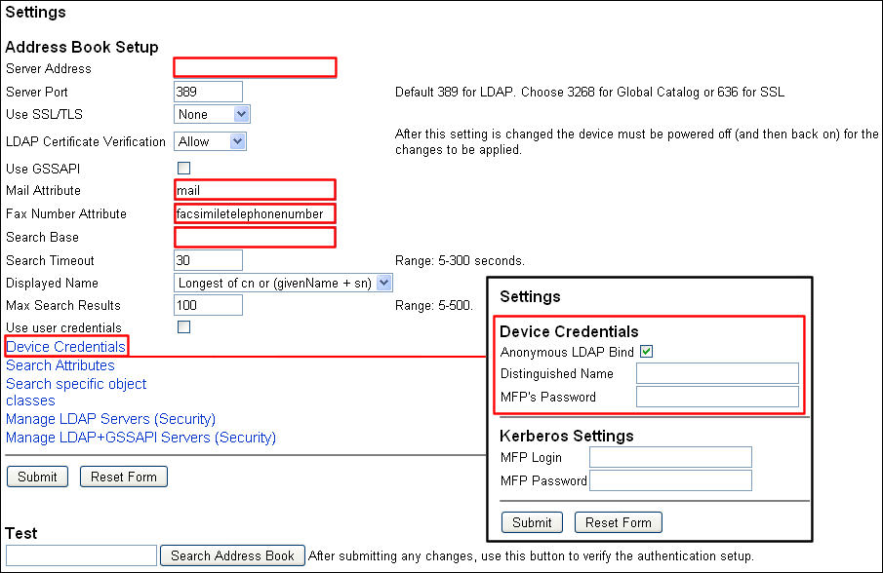
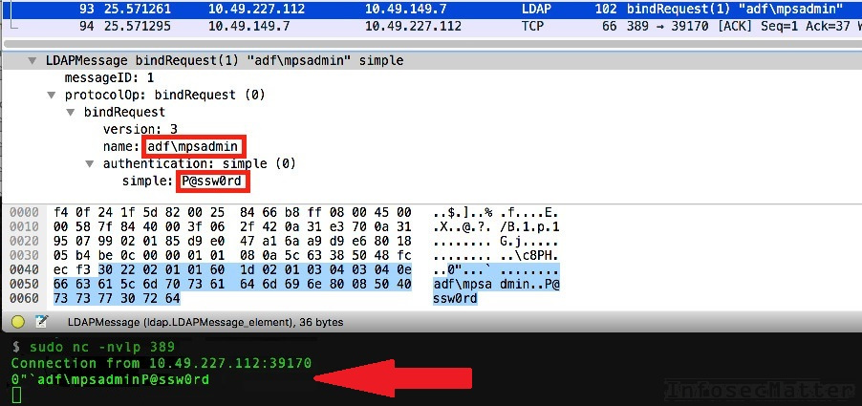

Slide 17
#5 Way from “Zero to Hero”
Scan entire network for eternal blue (MS17-010)
Run exploit
Dump Credentials

Slide 18
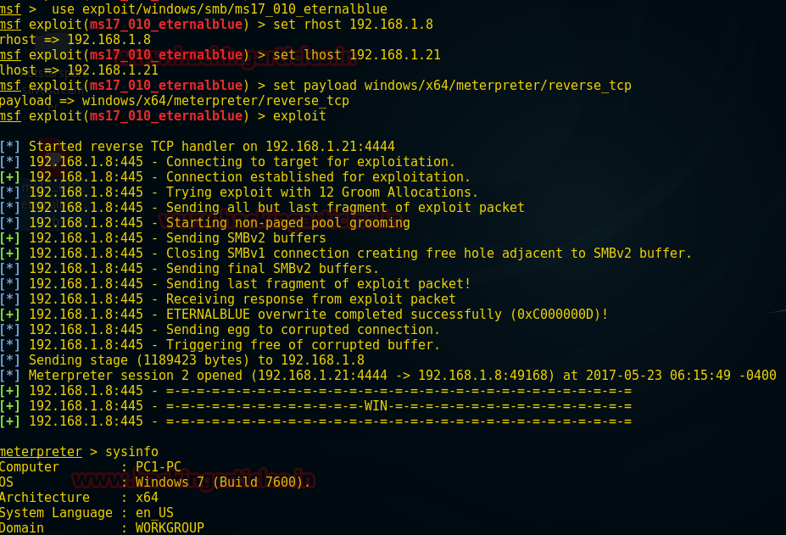

Slide 19
#6 Way from “Zero to Hero”
Scan entire network for Solarwinds Dameware Mini Remote Control RCE (CVE-2019-3980)
Run exploit
Dump Credentials

Slide 20
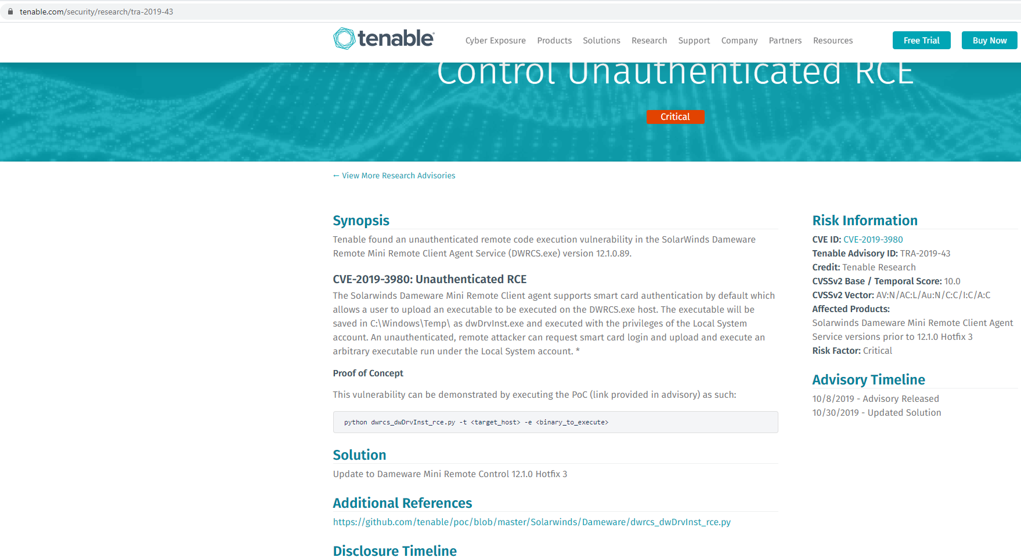

Slide 21
#7 Way from “Zero to Hero”
Run mitm6
Run ntlmrelayx
Watch computer get added to domain
Spray credentials
Note: This is adding a computer account to the domain and may get alerted (less stealthy).

Slide 22
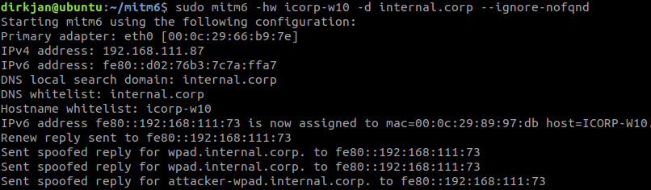
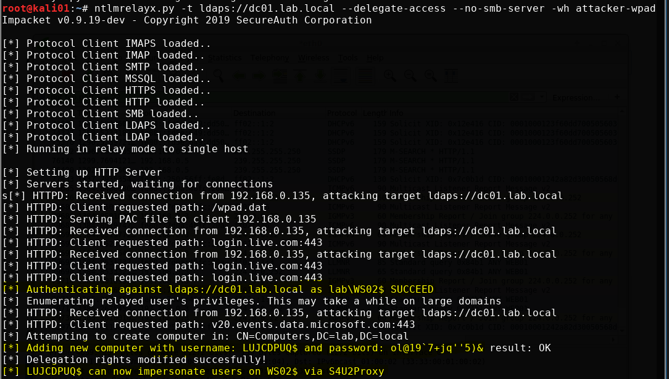
MiTM6 running
Machine account created

Slide 23
Mitigations
Patch Patch Patch!!!
Disable LLMNR and WPAD
Enforce SMB Signing Everywhere
Change all default credentials
Use password 14 characters or greater everywhere
Implement unique local admin password per device (LAPS)
Set up vLAN’s with strict ACL’s (network segmentation)
Disable unused services and cleartext protocols

Slide 24
References:
https://dirkjanm.io/worst-of-both-worlds-ntlm-relaying-and-kerberos-delegation/
http://foofus.net/goons/percx/praeda/pass-back-attack.pdf
https://www.rapid7.com/db/modules/exploit/windows/smb/ms17_010_eternalblue
https://github.com/byt3bl33d3r/CrackMapExec
https://github.com/SecureAuthCorp/impacket
https://github.com/SpiderLabs/Responder
Questions?

